Slide 1
Telecom Customer Churn Analysis
Submitted By: Christy Susan Philip
Tools: Tableau, Excel
Date: 02/20/2026

Slide 2
Introduction
Customer churn is a major challenge in the telecom industry because acquiring new customers costs more than retaining existing ones. This project analyzes customer behavior patterns to identify key factors influencing churn and to help the business take proactive retention actions.

Slide 3
Objective
Identify key drivers of customer churn
Analyze customer segments with high churn risk
Provide actionable insights to reduce churn
Support data-driven decision making

Slide 4
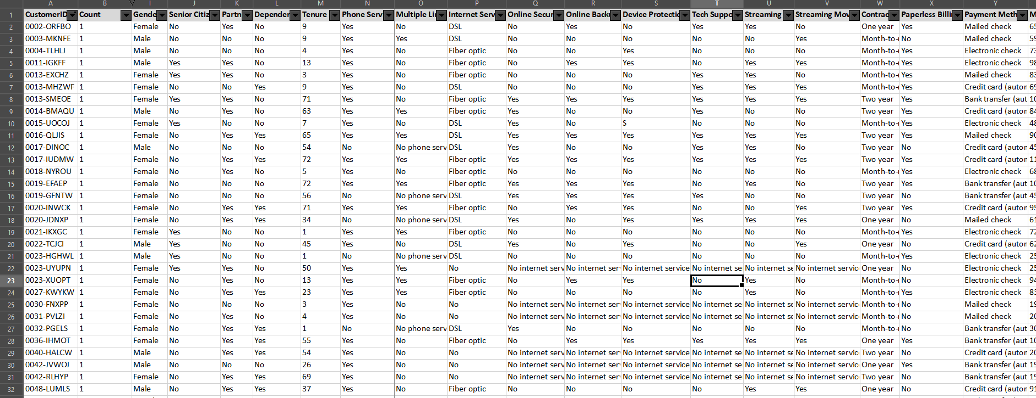
Dataset Used

Slide 5
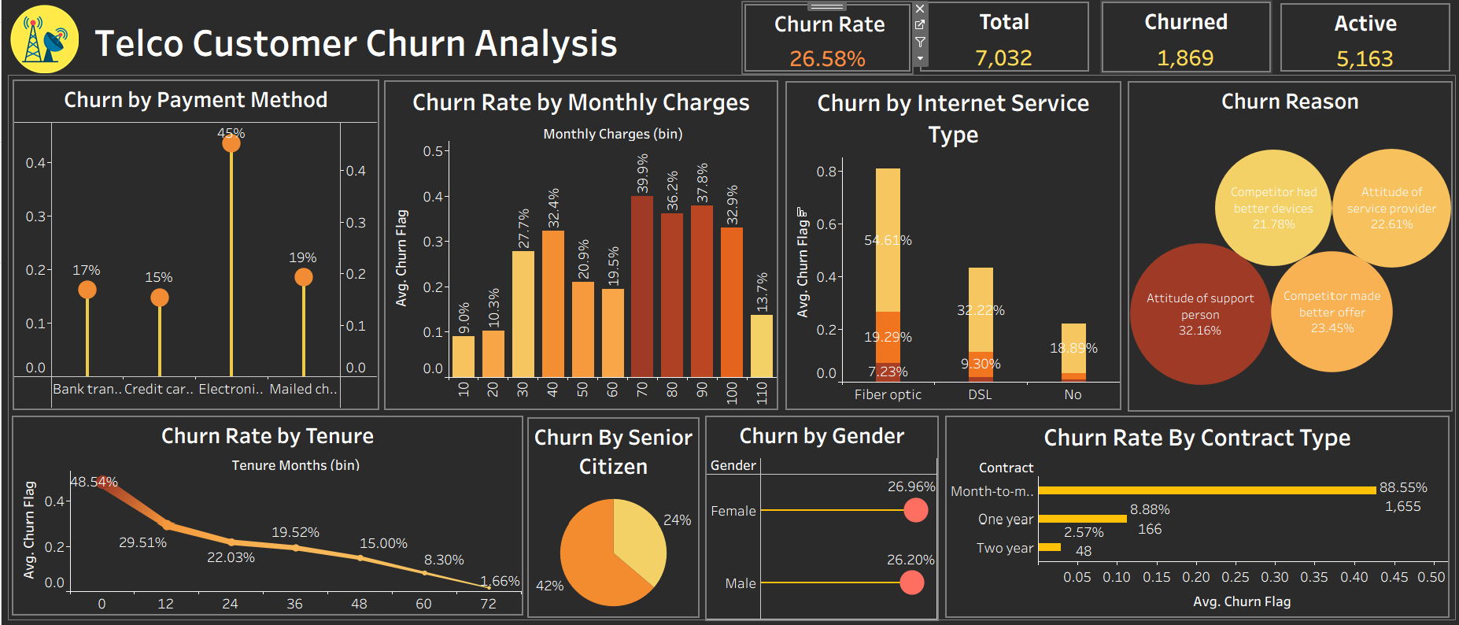
Dashboard Overview

Slide 6
Criteria Used — KPI & Methodology
Overall Approach
Customer churn analysis was performed by segmenting customers based on demographics, service usage, billing behavior, and contract attributes to identify high-risk churn groups.
KPI Calculation Logic
Total Customers
Count of unique customer IDs
Total Churned
Customers where Churn Label = Yes

Slide 7
Active Customers
Total Customers − Total Churned
Churn Rate-Calculated using customer-level churn flag
Formula:Churn Rate = (Total Churned Customers / Total Customers) × 100
Data Validation
Dataset reviewed for consistency.
Analysis performed on customer-level aggregated data. Null and duplicate checks performed where applicable.

Slide 8
Data Segmentation Criteria
Contract Type Analysis
Grouped by: Month-to-month, One year, Two year
Metric: Average churn flag
Purpose: Evaluate impact of contract commitment on churn
Tenure Analysis
Tenure grouped into monthly bins(0-12 range)
Metric: Average churn rate
Purpose: Identify lifecycle-based churn risk

Slide 9
Monthly Charges Analysis
Charges bucketed into value ranges
Metric: Average churn flag
Purpose: Assess price sensitivity
Internet Service Type
Categories: Fiber optic, DSL, No internet
Metric: Average churn rate
Purpose: Compare churn across service types

Slide 10
Payment Method
Categories: Electronic check, Mailed check, Bank transfer, Credit card
Metric: Average churn rate
Purpose: Identify payment behavior patterns
Customer Reason (Bubble Chart)
Grouped by churn reason
Bubble size: % of churned customers
Purpose: Highlight primary churn drivers

Slide 11
Gender & Senior Citizen
Segmented by demographic categories
Metric: Average churn rate
Purpose: Evaluate demographic influence on churn

Slide 12
Key Conclusions
Month-to-month contract customers are highest churn risk
Electronic Check Payments- linked to highest churn
Fibre optic customers- churn more than DSL(telephonic landline)
Highly monthly charges(0-10 range)- churn spikes.
Tenure- customers who survive the first year are more likely to stay long term.
Gender-wise churn rate is nearly identical (~26%), indicating gender is not a strong predictor of churn.
Senior citizens show a distinct churn pattern compared to non-senior customers.
Customer-reported churn reasons highlight competitor offers, customer support experience (attitude of service personnel), and device-related concerns as key drivers of attrition.

Slide 13
Business Recommendations
Based on the analysis, here are actions that can help reduce churn:
1. Improve onboarding for new customers(0-12 months).
2. Encourage long-term contracts with discounts.
3. Promote automatic payments methods over electronic checks.
4. Investigate Fibre Optic service quality issues.
5. Reward loyal customers with perks and recognition.
6. Establish service quality monitoring through regular call audits and customer feedback reviews.

Slide 14
References
Kaggle-https://www.kaggle.com/datasets/mustafaoz158/telco-customer-churn
Microsoft Excel

Slide 15
THANK YOU

